Slide 1

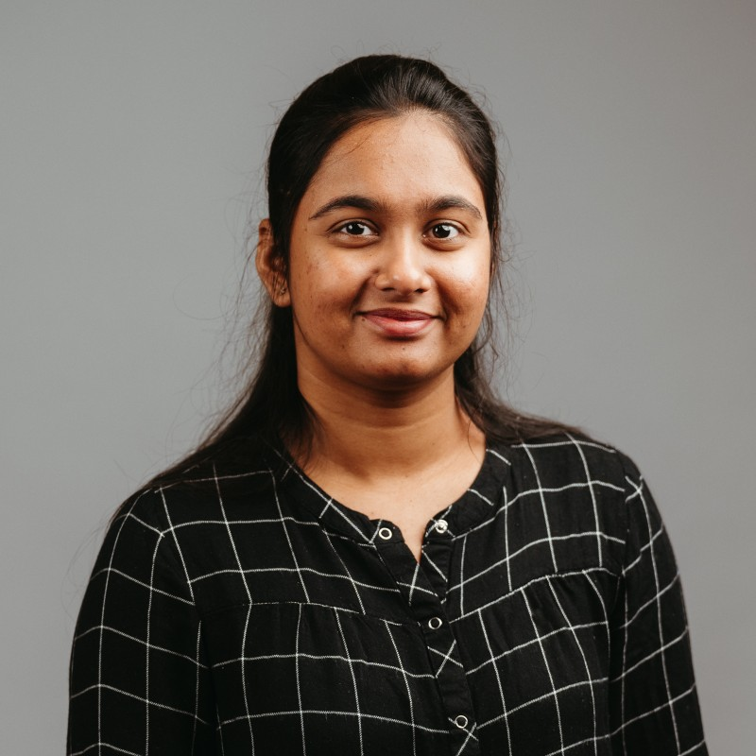

Sathvika Kotha (she/her/hers)
Work Experience:
Cloud Systems Intern at Purdue Rosen Center for Advanced Computing
Research Assistant at Purdue Rosen Center for Advanced Computing
Networking Engineer at CISCO Systems Pvt Ltd
MS in Computer and Information Technology, Purdue University.
Academic Goals:
My academic goals include pursuing advanced research in my field of study (Data Science and ML) and presenting my findings at prestigious conferences to contribute to the knowledge and advancement of my discipline.
Research Projects:
Researching Algorithmic Protocols for Robot-Assisted Triage in Mass Casualty Incidents
Working on a collaborative research project with IU Biomedical using Graph ML models
The Impact of Data Pre-processing on Machine Learning Fairness
Career Aspirations:
My career aspiration is to become a research scientist specializing in the fields of machine learning and artificial intelligence, with a specific focus on ensuring fairness and ethical considerations in the development and deployment of ML algorithms.
Conference Contributions and Engagements:
Tutorial on GPU Workloads on the Anvil Composable Platform
Rancher Overview
JupyterHub Deployment with Helm
Triton Inference Server Deployment
Application Monitoring
Personal Interests:
Some of my personal interests include participating in NGO activities, exploring new technologies, staying updated on the latest scientific advancements, and engaging in intellectual discussions. Additionally, I enjoy outdoor activities such as hiking, photography, and playing badminton.
Gain insights into cutting-edge trends in HPC, data analytics, and research computing, foster valuable connections with peers and industry professionals, and enhance research impact through presentation and expert feedback.

